Slide 1

B.Tech I-Year II-Sem
Subject: UI FRAMEWORKS
(MR23-1CS0106)

Slide 2
UNIT-IV ANGULAR

Slide 3

Syllabus UNIT IV ANGULAR
Forms- Template Driven Forms & Reactive Forms
Pipes
Angular Services and Dependency Injections
Angular HTTP services

Slide 4
Angular Forms
Handling user input with forms is the cornerstone of many common applications.
Applications use forms to enable users to log in, to update a profile, to enter sensitive information, and to perform many other data-entry tasks.
Angular provides two different approaches to handling user input through forms:
Template-driven forms
Reactive forms (or Model Driven Forms)

Slide 5
Template-Driven Forms:
Rely on directives in the template to create and manipulate the underlying object model.
They are useful for adding a simple form to an app, such as an email list signup form.
If you have very basic form requirements and logic that can be managed solely in the template, template-driven forms could be a good fit.
Features:
Easy to use
Suitable for simple scenarios but fails for dynamic applications
Similar to Angular 1.0
Minimal Component code
Automatic track of the form and its data

Slide 6
Template-Driven Forms: Example
App.component.ts:
import { Component } from '@angular/core';
import { CommonModule } from '@angular/common';
import { FormsModule } from '@angular/forms'; @Component({
selector: 'app-root',
standalone: true,
imports: [CommonModule,FormsModule],
templateUrl: './app.component.html',
styleUrl:'./app.component.css',
})
export class AppComponent {
user:any={
name:'',
email:'',
password:'',
}
onSubmit(){
console.log(this.user);
} }

Slide 7
Template-Driven Forms: Example
App.component.html:
<h1 style="text-align: center;"> Registration Form </h1>
<div
style="display: flex;
align-items: center;
justify-content: center;
height: 50vh;"
>
<form action="" (submit)="onSubmit()">
<div>
Name:<br><input type="text" placeholder="Name" name="name" [(ngModel)]="user.name"/>
@if (!user.name) {
<p>Name is Required</p>
}
</div>
<div>
Email: <br><input type="email" placeholder="Email" name="email" [(ngModel)]="user.email"/>
@if (!user.email) {
<p>Email is Required</p>
}
</div> <div>
Password: <br><input type="password" placeholder="Password" name="password" [(ngModel)]="user.password"/>
@if (!user.password) {
<p>Enter Password</p>
}
</div>
<button type="submit">Submit</button>
</form> </div>

Slide 8
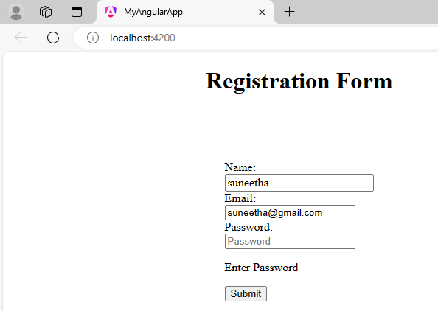
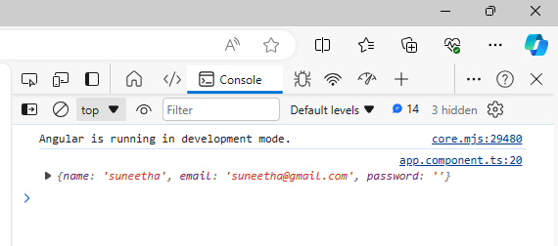
Template-Driven Forms: Example- OUTPUT

Slide 9
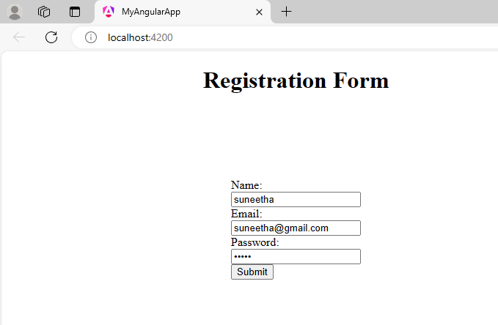
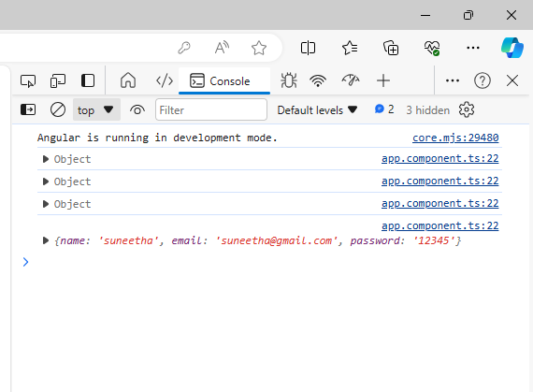
Template-Driven Forms: Example- OUTPUT

Slide 10
Reactive Forms:
Reactive forms provide a model-driven approach to handling form inputs whose values change over time.
Reactive forms use an explicit and immutable approach to managing the state of a form at a given point in time.
Reactive forms provide synchronous access to the data model, immutability with observable operators, and change tracking through observable streams.
Template-driven forms let direct access modify data in your template, but are less explicit than reactive forms because they rely on directives embedded in the template, along with mutable data to track changes asynchronously.

Slide 11
Reactive Forms:
app.component.ts file:
import { Component } from '@angular/core';
import { CommonModule } from '@angular/common';
import { FormControl, FormGroup, ReactiveFormsModule, Validators } from '@angular/forms';
@Component({
selector: 'app-root',
standalone: true,
imports: [CommonModule,ReactiveFormsModule],
templateUrl: './app.component.html',
styleUrl:'./app.component.css',
})
export class AppComponent {
userForm: FormGroup = new FormGroup({
firstName: new FormControl("", [Validators.required]),
lastName: new FormControl("",[Validators.required]),
email: new FormControl("", [Validators.required, Validators.email]),
})

Slide 12
Reactive Forms:
app.component.html:
<h1> Reactive Form </h1>
<form action="" [formGroup]="userForm">
<div>
<label>First Name</label> <br>
<input type="text" formControlName="firstName">
<span *ngIf="userForm.controls['firstName'].errors?. ['required']">This is required </span>
</div>
<div>
<label>Last Name</label> <br>
<input type="text" formControlName="lastName">
<span *ngIf="userForm.controls['lastName'].errors?. ['required']">This is required </span>
</div>

Slide 13
Reactive Forms:
app.component.html file:
<div>
<label>Email</label> <br>
<input type="text" formControlName="email">
<span *ngIf="userForm.controls['email'].errors?. ['required']">This is required </span>
<span *ngIf="userForm.controls['email'].errors?. ['email']">Enter valid email</span>
</div>
<br>
<button type="submit">Submit</button>
</form>

Slide 14
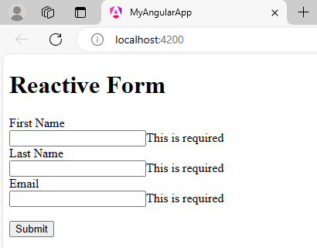
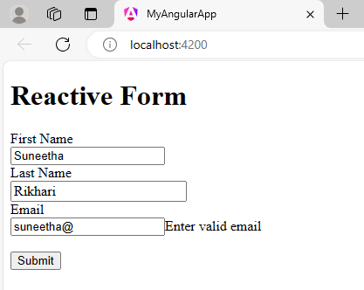
Reactive Forms: OUTPUT

Slide 15
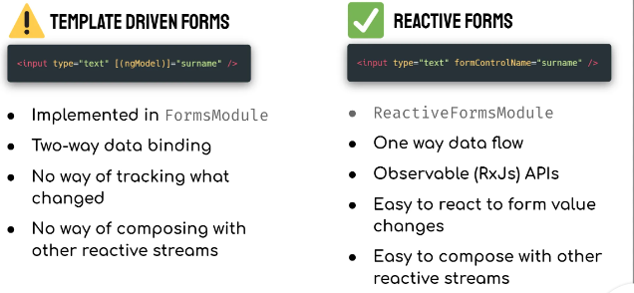

Slide 16
Pipes:
Angular Pipes are a way to transform the format of output data for display.
The data can be strings, currency amounts, dates, etc.
Pipes are simple functions that accept an input and return a transformed value in a more technical understanding.
They do not alter the data but change into the required format to display in the browser. Angular provides many built-in pipes for typical data transformation.
You can also create custom pipes if you want to do custom transformation.

Slide 17
Pipes:
Syntax:
{{title | uppercase}}
Pipe takes integers, strings, arrays, and date as input separated with |.
It transforms the data in the format as required and displays the same in the browser.

Slide 18


Slide 19
Features:
Pipes are defined using the pipe “|” symbol.
We can apply two formats to single data by chaining pipes. A chained pipe is when the output of the first pipe is input to the next pipe.
Pipes can have optional parameters using the colon(:) symbol to fine-tune the output

Slide 20
Categories of pipes
PURE PIPE
A pure pipe is only called when angular detects a change in the value or the parameter passed to a pipe
By default angular is in pure pipe
IMPURE PIPE
It is called every change detection cycle irrespective of the values and parameters

Slide 21
Types of pipes
There are two types of pipes:
Built in pipes
Custom pipes
BUILT IN PIPES
Angular built-in pipes are pipes that are provided by the angular library.

Slide 22
BUILT IN PIPES
Angular provides some built-in pipes:
Lowercase pipe
Uppercase pipe
Date pipe
Currency pipe
Json pipe
Percent pipe
Decimal pipe
Slice pipe

Slide 23
App.component.ts file
Example-BUILT IN PIPES
import { Component } from '@angular/core';
import { CommonModule } from '@angular/common'; @Component({
selector: 'app-root',
standalone: true,
imports: [CommonModule],
templateUrl: './app.component.html',
styleUrl:'./app.component.css', })
export class AppComponent {
title = 'my-first-app';
todaydate = new Date();
val = {name: 'Alex', age: '25', address:{a1: 'Paris', a2: 'France'}};
months = ['Jan', 'Feb', 'Mar', 'April', 'May', 'Jun',
'July', 'Aug', 'Sept', 'Oct', 'Nov', 'Dec'];
}

Slide 24
App.component.html file
<h1>PIPES</h1>
<h1>Uppercase Pipe</h1>
<b>{{title | uppercase}}</b><br/>
<h1>Lowercase Pipe</h1>
<b>{{title | lowercase}}</b>
<h1>Currency Pipe</h1>
<b>{{6589.23 | currency:""}}</b><br/>
<h1>Date pipe</h1>
<b>{{todaydate | date:'d/M/y'}}</b><br/>
<b>{{todaydate | date:'shortTime'}}</b>
<h1>Decimal Pipe</h1>
<b>{{ 454.78787814 | number: '3.4-4' }}</b>
// 3 is for main integer, 4 -4 are for integers to be displayed.
<h1>Json Pipe</h1>
<b>{{ val | json }}</b>
<h1>Percent Pipe</h1>
<b>{{00.54565 | percent}}</b>
<h1>Slice Pipe</h1>
<b>{{months | slice:2:6}}</b>
// here 2 and 6 refers to the start and the end index
App.component.css file
h1{ color: red;}

Slide 25
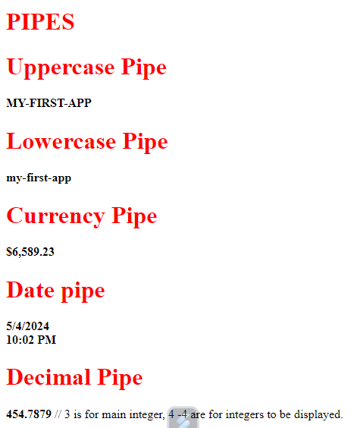
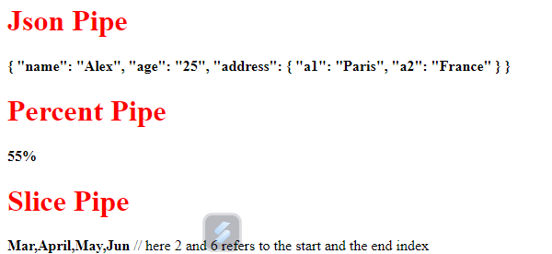
OUTPUT

Slide 26
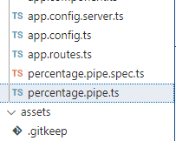
CUSTOME PIPE
Create custom pipes to encapsulate transformations that are not provided with the built-in pipes.
Then, use your custom pipe in template expressions, the same way you use built-in pipes—to transform input values to output values for display.
Generate pipe using command
ng g p percentage<name of the pipe>

Slide 27
CUSTOM PIPE
app.component.ts file:
import { Component } from '@angular/core';
import { CommonModule } from '@angular/common';
import { PercentagePipe } from './percentage.pipe';
@Component({
selector: 'app-root',
standalone: true,
imports: [CommonModule,PercentagePipe],
templateUrl: './app.component.html',
styleUrl: './app.component.css'
})
export class AppComponent {
value:number=156
total:number=600
}
percentage.pipe.ts file:
import { Pipe, PipeTransform } from '@angular/core';
@Pipe({
name: 'percentage',
standalone: true
})
export class PercentagePipe implements PipeTransform {
transform(value: number, total: number, ): any {
return (value/total*100) + '%';
}
}

Slide 28
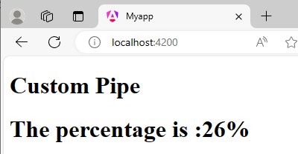
CUSTOME PIPE
app.component.html:
<h1>Custom Pipe</h1>
<h1>The percentage is :{{value| percentage:total}}</h1>

Slide 29
Angular Services and Dependency Injections:
Angular Service is a mechanism used to share common functionality between the components.
Services provides an abstraction layer that handles an application’s business logic, which usually includes communicating with a backend and parsing/returning data or datasets.
Services are used when you need to use the same code across multiple components.
This is done by creating a single reusable data service and inject it into the component that needs it.

Slide 30
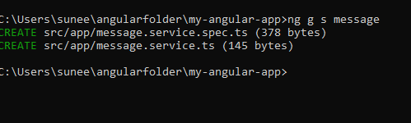
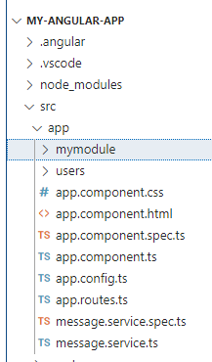
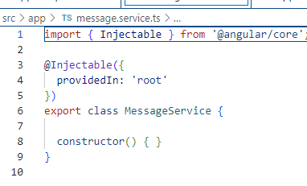
Creating Angular Service:
Navigate to the app folder and type the following command to generate service:
ng g s nameofService

Slide 31
Angular Services and Dependency Injection Example:
message.service.ts file:
import { Injectable } from '@angular/core';
@Injectable({
providedIn: 'root'
})
export class MessageService {
mymessage="Hello !! Welcome to Angular Services Class"
getmessage() {
return this.mymessage;
}
}
app.component.html :
<div style="text-align: center;">
<h1>ANGULAR SERVICES</h1>
<button (click)="getmessage()" > GET MESSAGE</button> <br>
Your Message: <h3> {{msg}}</h3>
</div>

Slide 32
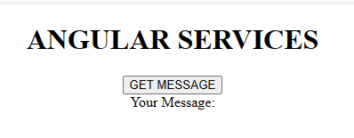
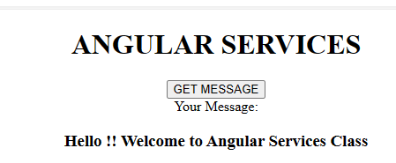
Angular Services and Dependency Injection Example:
app.component.ts:
import { Component } from '@angular/core';
import { MessageService } from './message.service'; @Component({
selector: 'app-root',
standalone: true,
imports: [],
templateUrl: './app.component.html',
styleUrl:'./app.component.css',
})
export class AppComponent {
msg: string=""
constructor( private messageService:MessageService) {
} getmessage(){
this.msg=this.messageService.getmessage();
}
}

Slide 33
Angular HTTP Services
Most front-end applications need to communicate with a server over the HTTP protocol, to download or upload data and access other back-end services.
Angular provides a client HTTP API for Angular applications (the HttpClient service class in @angular/common/http.)
HTTP client service features:
The HTTP client service offers the following major features:
The ability to request typed response values
Streamlined error handling
Request and response interception
Robust testing utilities

Slide 34
Angular HTTP Services
SERVER
HTTP REQUEST
DATABASE
ANGULAR APP
------------
------------
------------
------------
------------
API
HTTP RESPONSE
Angular cannot be connected directly to the database , because it is highly insecure to put the data in the User Interface code.
Hence, angular communicates with the database through API (Application Programming Interface)

Slide 35
Angular HTTP Services
Angular sends the HTTP request to the API and as a response API sends the JSON data. (not HTML data).The JSON data is converted into JavaScript objects and is then used in the frontend application.
Angular is used for creating frontend application, it is not used for creating API’s. API’s are created using server side programming languages like python, node, PHP etc.
API contains the code to interact with the database like fetching, updating, deleting the data etc.

Slide 36
Angular HTTP Request Core Parts
Following are the HTTP request core parts:
URL
HTTP Verbs
Headers
Body
URL:
The most important part of an HTTP request is the URL to which we are sending the request. If we are making an HTTP request to an API, in that case this URL is also called as API end point.
For example: yourdomain.com/api/products/id

Slide 37
Angular HTTP Request Core Parts
2. HTTP Verbs:
When connecting with the API’s, it is not just the URL which matters, but also the HTTP verbs we are using.
HTTP verbs define, which type of request you want to send to the API endpoint.
Some of the HTTP verbs available to perform specific tasks are listed below:
GET – used to read data from server
POST- used to create new data on the server.
PUT- used to update existing data on the server.
DELETE- used to delete data on the server.
PATCH- used to update partial data on the server.

Slide 38
Angular HTTP Request Core Parts
3. HTTP Request Headers:
When making HTTP request to the server, along with API end point and HTTP verbs, we also need to send some additional metadata to the server with the request we are sending.
HTTP request Headers are optional and usually clients will set some default headers fro an HTTP request.
However, it is also possible to set HTTP request headers of our own when sending request to the server

Slide 39
Angular HTTP Request Core Parts
4. Request Body:
For some of the HTTP verbs, we also need to specify the body i.e, the data which we want to send with the request.
Not all the requests need to have a body. HTTP requests like POST, PUT, PATCH etc, need to have a body. And requests like GET need not to have a body.

Slide 40
HTTP: Setup for server communication
Before you can use HttpClient, you must add it to the application's root dependency injector.
Most apps do so in the providers array of ApplicationConfig in app.config.ts.
app.config.ts file:
import { ApplicationConfig } from '@angular/core';
import { provideRouter } from '@angular/router';
import { routes } from './app.routes';
import { HttpClientModule } from '@angular/common/http';
export const appConfig: ApplicationConfig = {
providers: [provideRouter(routes), HttpClientModule ]
};

Slide 41
THANK YOU

